Slide 1
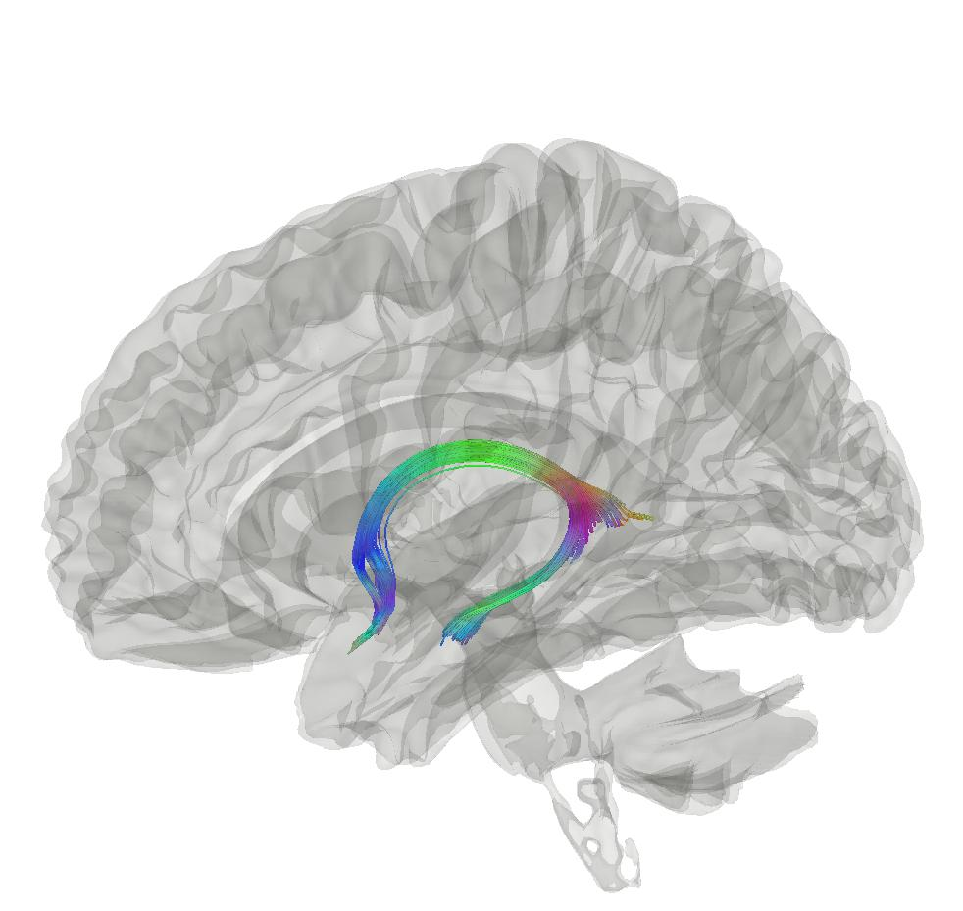



Brain biomarkers of ageing and disease
Max Korbmacher
PhD Student at the Western Norway University of Applied Sciences, Bergen
Max.Korbmacher@hvl.no

Slide 2
A quick run-through of my project
Brain ageing as a proxy of “health”
Investigating brain age
Brain age gap as biomarker?

Slide 3
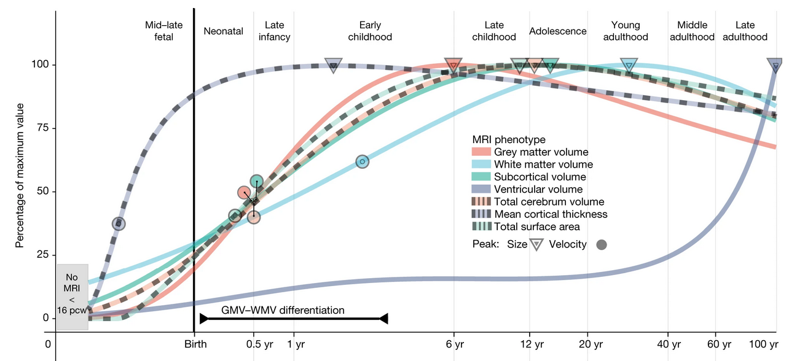
Brain ageing as a “health” proxy
There are normative patterns of brain tissue development throughout the lifespan
Non-normativ development can indicate illness and symptom development¹
Establishing normative patterns requires big data²
1 Rutherford et al., 2022, Elife, 11; 2 Marek et al., 2022, Nat., 603(7902)

Slide 4
Investigating brain age: Challenges
Ageing has multiple facets
Cross-sectional vs longitudinal
Different tissue types
Different data & data representations
Sequences
2D-3D vs tabular data

Slide 5
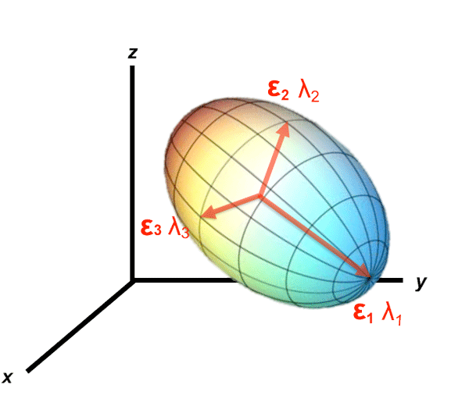
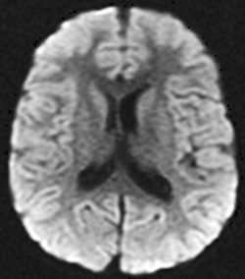
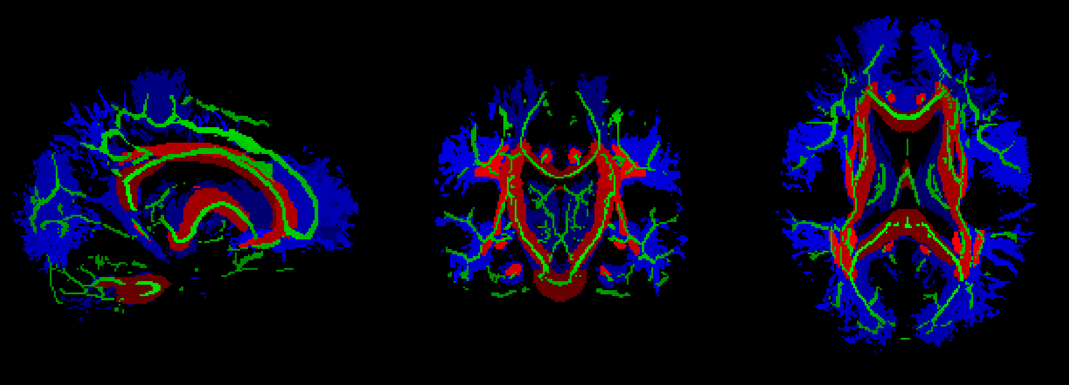
Investigating brain age: Focussing on white matter
Diffusion MRI as data source
A
B
C

Slide 6

Investigating brain age: Which data, what to do with it?
UK Biobank ~ 50,000 cross-sec scans
Brain age predictions
Association testing of key regions with age

Slide 7
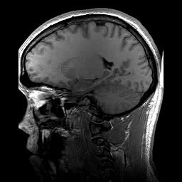
Brain age gap as biomarker?
Brain age gap (BAG) calculation
Train a model from MR data
Do age predicitons for each individual: “Your brain is X years old”
Calculate the difference between chronological and predicted age
BAG associations
Related with a whole bunch of clinical symptoms and diagnoses¹
Larger in several clinical groups vs controls¹
Chronologically 22 years old
Age prediction
Biologically 28 years old gammel
BAG = 6 years
1 Franke & Gaser, 2019, Front. Neurol., 789

Slide 8
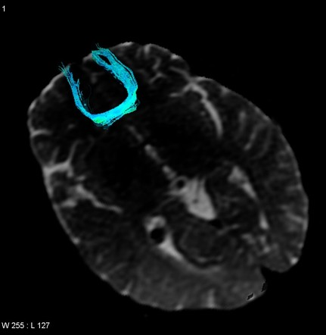
Brain age gap as biomarker?
Our studies (½)
Brain age estimates similar across diffusion approaches (DTI, DKI, …)
Most important features for brain age predictios: fornix & forceps minor¹
Brain age & BAG related with several cardiometabolic, cognitive & biopsychosocial factors²
waist-to-hip ratio, diabetes, hypertension, smoking, matrix puzzles solving, job- & health satisfaction and perception
1 Korbmacher et al., 2023, Hum. Brain Map. 44(10); 2 Korbmacher et al., 2023, Front. Psy. 14.

Slide 9
Brain age gap as biomarker?
Our studies (2/2)
Brain age estimates are however suspecible to scan quality and other factors¹
Not ready for clinical application.
However, we identified most age-sensitive regions (such as fornix) were also as relevant for:
asymmetry development²
Ageing (longitudinal), & we present unique polygenic fingerprints³
1 Korbmacher et al., 2023, Brain & Beh. e3219; 2+3 Korbmacher et al., 2023, preprint.

Slide 10
Summary
Brain age is a general indicator of health, yet limited for clin. usage
Yet, we find fornix & forceps (corpus callosum) to be central in age predictios and various other age-related aspects in the UKB
Next Qs: Can we create integrative biomarkers considering also genes & beh.?

Slide 11


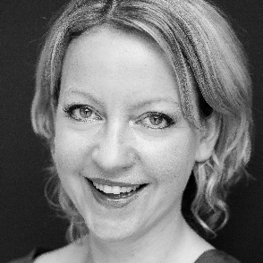




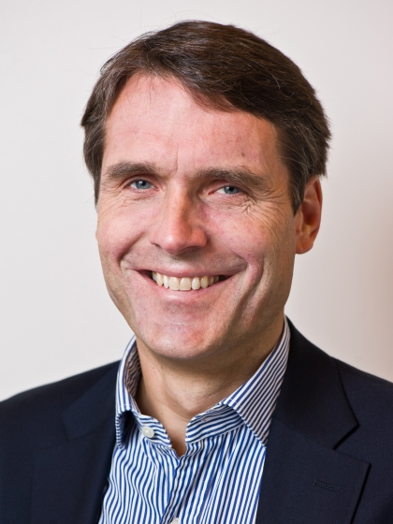

Ivan I. Maximov
Lars T. Westlye
Eli N. Eikefjord
Arvid Lundervold
Takk!
Dennis van der Meer
Ann Marie de Lange
Dani Beck
Ole A. Andreassen
Tiril Gurholt

Slide 12
Spørsmål?

